Slide 1

Pancreatic Cancer Detection Using Deep Learning
BCA (DATA SCIENCE)
Student Name :
HARINI S
(221421601015)
LAVANYA M
(221421601021)
Supervisor :Mrs.T.PANDIYAVATHI
Designation :Assistant professor (Senior Grade)
DEPARTMENT OF COMPUTER APPLICATIONS

Slide 2
ABSTRACT
Pancreatic cancer is often diagnosed too late, making early detection essential for improving patient survival.
We use deep learning, specifically the VGG19 model, to analyze RBC and WBC images for early signs of cancer.
Our method achieves approximately 98% accuracy by identifying subtle blood cell changes that are difficult to detect with the human eye.
This system can be integrated into hospital diagnostics to support faster, more accurate cancer detection and improve treatment outcomes.
DEPARTMENT OF COMPUTER APPLICATIONS

Slide 3
LITERATURE SURVEY
S.No | TITLE | AUTHOR/ JOURNAL | YEAR | ALGORTHIM | ADVANTAGE | DISADVANTAGE
1 | Radiomics and Deep Learning for Diagnosis | Zhao L., Park S./ NSR | 2024 | Convolutional neural network | Combines radiomic features with deep learning | Requires expertise in radiomics, may face feature extraction challenges
2 | Transfer Learning for Small Dataset Pancreatic Cancer Detection | Patel S., Liu X./IEEE | 2023 | Tansfer learning | Overcomes small dataset challenges | May not perform as well on domain-specific data, requires fine-tuning
S.NO | TITLE | AUTHOR | YEAR | ALGORITHMS
1 | Deep Learning Models for Early Detection of Pancreatic Cancer in CT Scans | Smith J., Wang L., et al. | 2022 | Convolutional Neural Networks (CNNs) with transfer learning
2 | Hybrid Deep Learning Approach for Pancreatic Cancer Diagnosis | Patel R., Kim H., et al. | 2021 | CNNs combined with Long Short-Term Memory (LSTM) networks
3 | Pancreatic Tumor Segmentation Using 3D U-Net Architecture | Zhao X., Lee Y., et al. | 2023 | 3D U-Net for volumetric segmentation
DEPARTMENT OF COMPUTER APPLICATIONS

Slide 4
LITERATURE SURVEY
S.No | TITLE | AUTHOR/ JOURNAL | YEAR | ALGORTHIM | ADVANTAGE | DISADVANTAGE
3 | GANs for Data Augmentation | Smith J., Chen Y./MDPI | 2023 | GANs | Generates synthetic data | Generates synthetic data, improves model generalizatin
4 | Deep Learning for Cancer Staging | Johnson K., Wang T./IEEE | 2023 | CNN-based Deep Learning | Accurately stages pancreatic cancer | Requires large datasets, may overfit
S.NO | TITLE | AUTHOR | YEAR | ALGORITHMS
1 | Deep Learning Models for Early Detection of Pancreatic Cancer in CT Scans | Smith J., Wang L., et al. | 2022 | Convolutional Neural Networks (CNNs) with transfer learning
2 | Hybrid Deep Learning Approach for Pancreatic Cancer Diagnosis | Patel R., Kim H., et al. | 2021 | CNNs combined with Long Short-Term Memory (LSTM) networks
3 | Pancreatic Tumor Segmentation Using 3D U-Net Architecture | Zhao X., Lee Y., et al. | 2023 | 3D U-Net for volumetric segmentation
DEPARTMENT OF COMPUTER APPLICATIONS

Slide 5
LITERATURE SURVEY
S.NO | TITLE | AUTHOR/ JOURNAl | YEAR | ALGORTHIM | ADVANTAGE | DISADVANTAGE
5 | Deep Learning Models for Early Detection of Pancreatic Cancer in CT Scans | Smith J., Wang L., et al./Springer | 2022 | CNNs with transfer learning | High accuracy in detecting tumors in CT scans | Requires large and high-quality annotated datasets to achieve optimal results
6 | AI tool detects pancreatic cancer with deep ensemble learning | Garcia L., Wang /IEEE | 2022 | Convolutional neural network | Robust to overfitting compared to single-model approaches | More computationally intensive than using a single model
S.NO | TITLE | AUTHOR | YEAR | ALGORITHMS
1 | Deep Learning Models for Early Detection of Pancreatic Cancer in CT Scans | Smith J., Wang L., et al. | 2022 | Convolutional Neural Networks (CNNs) with transfer learning
2 | Hybrid Deep Learning Approach for Pancreatic Cancer Diagnosis | Patel R., Kim H., et al. | 2021 | CNNs combined with Long Short-Term Memory (LSTM) networks
3 | Pancreatic Tumor Segmentation Using 3D U-Net Architecture | Zhao X., Lee Y., et al. | 2023 | 3D U-Net for volumetric segmentation
DEPARTMENT OF COMPUTER APPLICATIONS

Slide 6
LITERATURE SURVEY
S.NO | TITLE | AUTHOR/ JOURNAL | YEAR | ALGORTHIM | ADVANTAGE | DISADVANTAGE
7 | Pancreatic Tumor Segmentation Using 3D U-Net Architecture | Zhao X., Lee /Wiley | 2022 | 3D U-Net for volumetric segmentation | Effective in handling volumetric data, leading to more precise localization of tumors | Requires significant computational resources for processing 3D data
8 | Explainable AI in Pancreatic AI tool detects pancreatic cancer with deep ensemble learning | Kumar P., Hernandez /Frontiers Media | 2022 | Explainable AI boosts cancer diagnosis | Improves model interpretability, Increases transparency | Additional computational -overhead
S.NO | TITLE | AUTHOR | YEAR | ALGORITHMS
1 | Deep Learning Models for Early Detection of Pancreatic Cancer in CT Scans | Smith J., Wang L., et al. | 2022 | Convolutional Neural Networks (CNNs) with transfer learning
2 | Hybrid Deep Learning Approach for Pancreatic Cancer Diagnosis | Patel R., Kim H., et al. | 2021 | CNNs combined with Long Short-Term Memory (LSTM) networks
3 | Pancreatic Tumor Segmentation Using 3D U-Net Architecture | Zhao X., Lee Y., et al. | 2023 | 3D U-Net for volumetric segmentation
DEPARTMENT OF COMPUTER APPLICATIONS

Slide 7
LITERATURE SURVEY
S.NO | TITLE | AUTHOR/ JOURNAl | YEAR | ALGORTHIM | ADVANTAGE | DISADVANTAGE
9 | Hybrid Deep Learning Approach for Pancreatic Cancer Diagnosis | Patel R., Kim/ IEEE | 2021 | CNN-LSTM combination. | Combines spatial and temporal data, improving diagnostic performance. | Needs extensive labeled data for LSTM training.
10 | Multi-Modal Deep Learning for Pancreatic Cancer Risk Assessment | Johnson A., Singh /MDPI | 2021 | Multi-modal CNN with clinical and genomic data. | Higher potential for accurate risk assessment and early detection. | Complex and requires extensive data preprocessing.
S.NO | TITLE | AUTHOR | YEAR | ALGORITHMS
1 | Deep Learning Models for Early Detection of Pancreatic Cancer in CT Scans | Smith J., Wang L., et al. | 2022 | Convolutional Neural Networks (CNNs) with transfer learning
2 | Hybrid Deep Learning Approach for Pancreatic Cancer Diagnosis | Patel R., Kim H., et al. | 2021 | CNNs combined with Long Short-Term Memory (LSTM) networks
3 | Pancreatic Tumor Segmentation Using 3D U-Net Architecture | Zhao X., Lee Y., et al. | 2023 | 3D U-Net for volumetric segmentation
DEPARTMENT OF COMPUTER APPLICATIONS

Slide 8
1.Limited Accuracy in WBC Classification: Existing automated systems for White Blood Cell (WBC) classification from microscopic images often face challenges in achieving high segmentation accuracy and generalization across diverse datasets.
Late Diagnosis of Pancreatic Cancer: Traditional detection methods for pancreatic cancer are inefficient, leading to late-stage diagnoses and poor prognosis.
Deep Learning Potential: Although advanced deep learning methods (e.g., radiomics, transfer learning, GANs, ensemble models) show potential in enhancing medical image-based diagnosis, their clinical adoption remains limited.
Implementation Challenges: Key barriers such as limited availability of annotated datasets, lack of model interpretability, and high computational demands restrict the practical use of deep learning in medical diagnostics.
PROBLEM STATEMENT
DEPARTMENT OF COMPUTER APPLICATIONS

Slide 9
OBJECTIVE
Develop a user-friendly graphical tool for medical image analysis focused on pancreatic cancer detection.
Automate grayscale conversion, binarization, noise removal, and image classification using a trained CNN model.
Identify and count white blood cells (WBCs), highlighting cancer-affected regions in blood smear images.
Provide visual and text-based diagnosis output to support early, reliable cancer detection.
DEPARTMENT OF COMPUTER APPLICATIONS

Slide 10
BASE PAPER
Base paper Title: A Controllability Reinforcement Learning Method for Pancreatic Cancer Biomarker Identification.
Authors: Yan Wang , Member, IEEE, Jie Hong , Yuting Lu , Nan Sheng , Graduate
Student Member, IEEE, Yuan Fu , Lili Yang, Lingyu Meng, Lan Huang , and Hao Wang.
Year: 2024
Objective: The objective of the paper is propose a method, RDDriver, to identify biomarkers for pancreatic cancer. The method combines Relational Graph Convolutional Networks (RGCN) and Deep Q-Network (DQN) within a multi-layer heterogeneous transcriptional regulation network framework.
Limitation: Current methods for detecting RNA biomarkers have limitations, relying on prior knowledge, and lacking research on all three types (lncRNA, microRNA, mRNA), and overlooking individual node importance.
DEPARTMENT OF COMPUTER APPLICATIONS

Slide 11
EXISTING WORK
Existing WBC classification systems use various approaches, including traditional machine learning and modern deep learning techniques.
Traditional methods rely on handcrafted features for classification.
Deep learning techniques utilize automated feature extraction for improved accuracy.
These systems aim to overcome the limitations of manual microscopic examination.
The goal is to provide efficient and accurate solutions for hematological analysis.
DEPARTMENT OF COMPUTER APPLICATIONS

Slide 12
PROPOSED WORK
A graphical tool is developed to perform end-to-end medical image analysis for pancreatic cancer detection.
The system allows users to upload a blood smear image and process it through steps like grayscale conversion, binarization, and noise removal.
A pre-trained Convolutional Neural Network (CNN) model classifies the image to detect the presence of cancer.
It automatically counts white blood cells (WBCs) and detects cancer-affected regions, marking them on the image.
The final output displays a clear visual with bounding boxes and a text-based summary showing WBC count, cancer status, confidence level, and
affected cell count.
DEPARTMENT OF COMPUTER APPLICATIONS

Slide 13
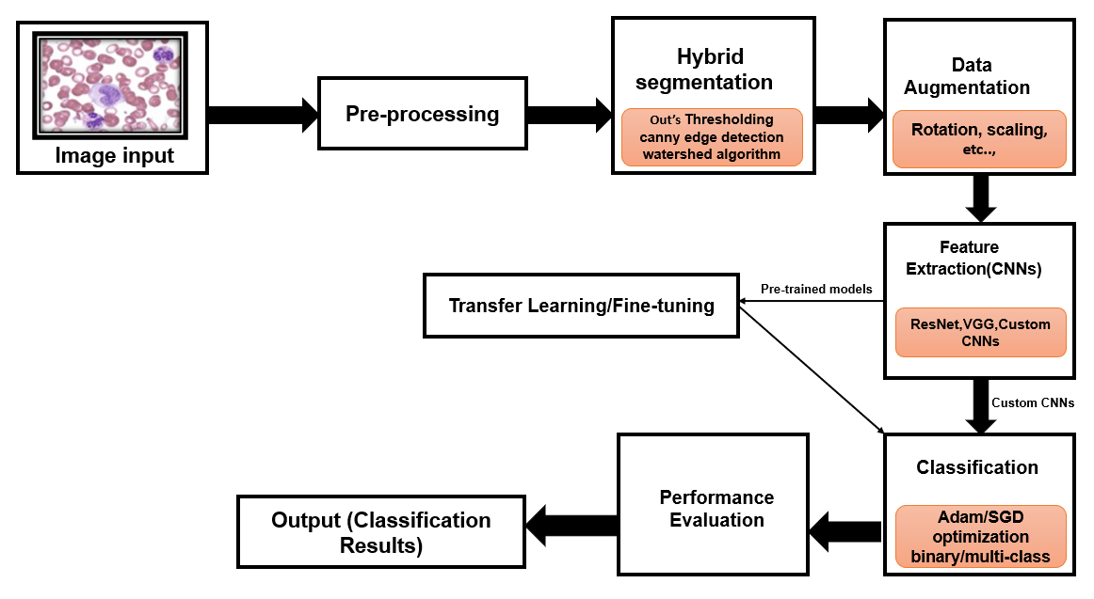
ARCHITECTURE DIAGRAM
DEPARTMENT OF COMPUTER APPLICATIONS

Slide 14
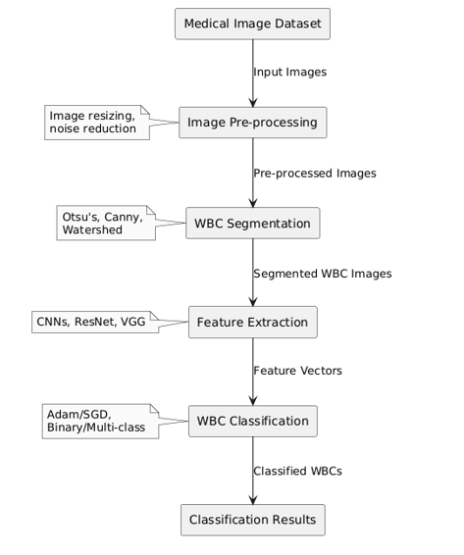
DATA FLOW DIAGRAM
DEPARTMENT OF COMPUTER APPLICATIONS

Slide 15
ALGORITHM DETAILS
Image Selection:
The user selects a medical image (JPEG, PNG, BMP, TIFF).
The image is loaded into the system and displayed on the graphical user interface (GUI).
2. Grayscale Conversion:
The selected image is converted from RGB (colored) to grayscale (black and white).
This helps in simplifying the image for further analysis.
3. Binarization:
The grayscale image is converted into a binary image (black & white) using adaptive binarization. This separates foreground objects (like cells) from the background.
DEPARTMENT OF COMPUTER APPLICATIONS

Slide 16
ALGORITHM DETAILS
4. Noise Removal:
Small noise particles in the binary image are removed using the
bwareaopen function. .
This results in a cleaner image for better analysis.
5. Image Classification (Cancer Detection) :
The resized image is passed through a pre-trained Convolutional
Neural Network (CNN)
The CNN classifies the image as either “Cancer Detected” or “No
Cancer Detected” based on learned patterns.
6. White Blood Cell (WBC) Count:
The number of white blood cells is calculated by detecting connected
components in the binarized grayscale image.
The WBC count is displayed on the GUI.
DEPARTMENT OF COMPUTER APPLICATIONS

Slide 17
ALGORITHM DETAILS
7. Cancer-Affected Region Detection:
If cancer is detected, regions with a purple hue in the HSV color space are isolated.
The affected areas are marked with red bounding boxes on the image.
8. Result Formatting:
The results, including WBC count, cancer status, confidence score, and affected cell count, are formatted.
These results are displayed in a text panel and on the image for visual feedback.
.
DEPARTMENT OF COMPUTER APPLICATIONS

Slide 18
METHODOLOGY
1. Data Acquisition & Preprocessing:
Load microscopic blood smear images through the "Select Image" option.
Convert images to grayscale or binary and apply noise removal for preprocessing.
2. Segmentation:
Use adaptive thresholding and morphological operations to segment White Blood Cells (WBCs) and refine boundaries.
3. Feature Extraction:
Analyze segmented regions to extract features such as WBC count and affected cell regions using region properties.
DEPARTMENT OF COMPUTER APPLICATIONS

Slide 19
METHODOLOGY
4. Classification:
Resize images and preprocess them for input to the pre-trained CNN model (trainedNet).
Classify the presence of cancer with confidence scores.
5. Visualization:
Overlay bounding boxes on affected regions if cancer is detected.
Display WBC count, cancer status, and confidence in the result panel.
6. User Interface:
Provide interactive buttons for image preprocessing, segmentation, and analysis.
Display results in a clear and organized manner.
DEPARTMENT OF COMPUTER APPLICATIONS

Slide 20
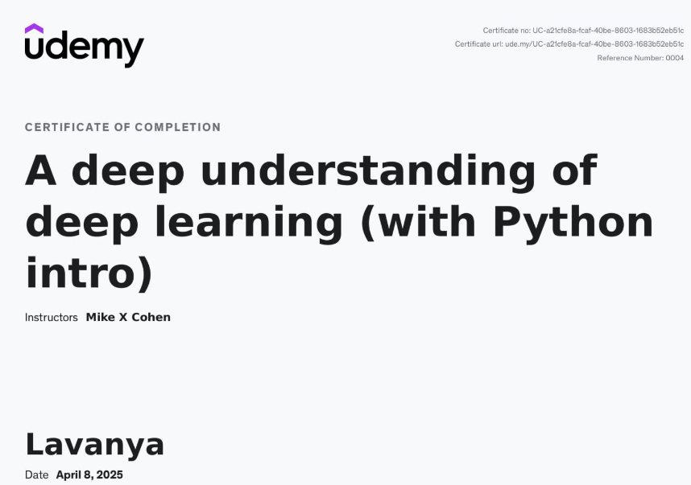
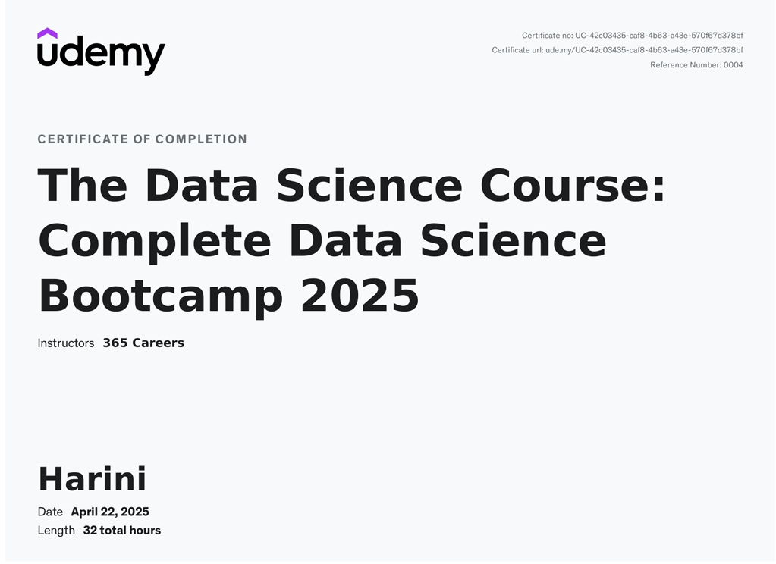
Certification on completion tentative class date:
TECHNOLOGY CERTIFICATION
DEPARTMENT OF COMPUTER APPLICATIONS

Slide 21
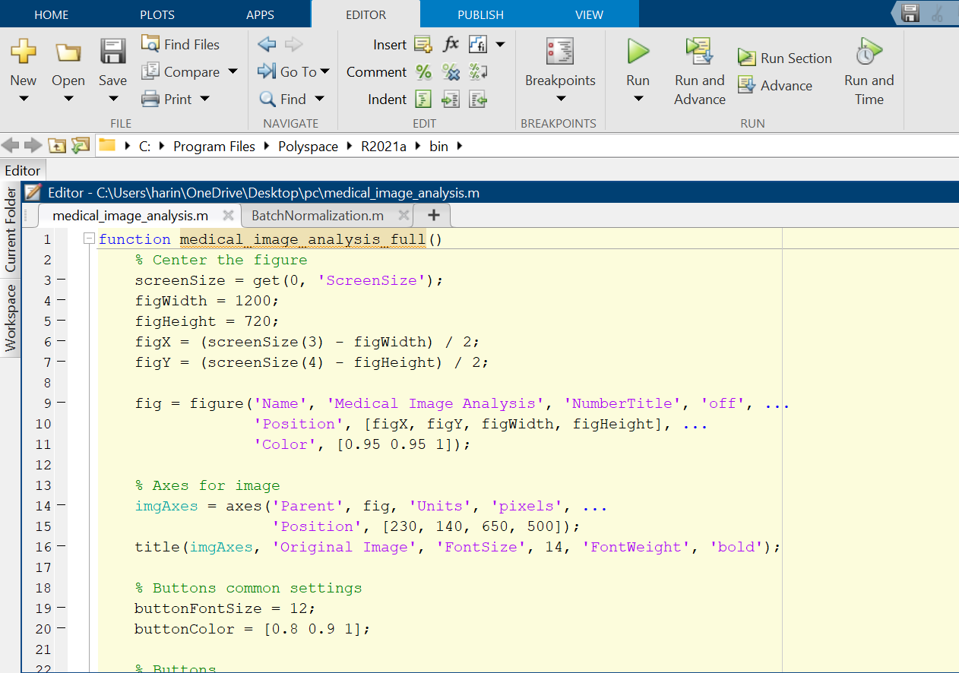
CODING
DEPARTMENT OF COMPUTER APPLICATIONS

Slide 22
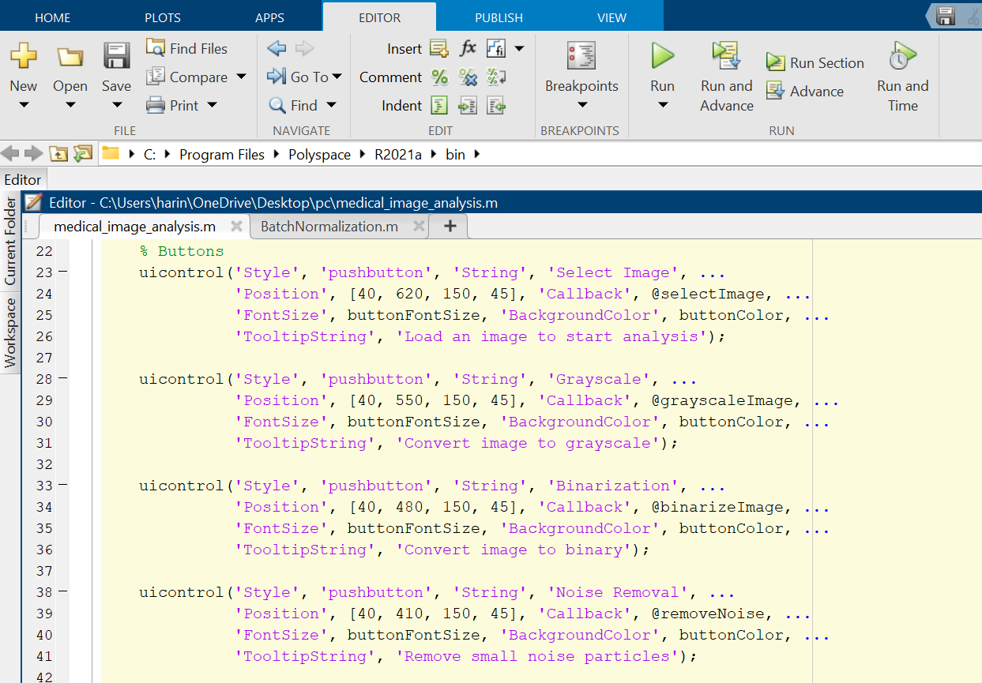
CODING
DEPARTMENT OF COMPUTER APPLICATIONS

Slide 23
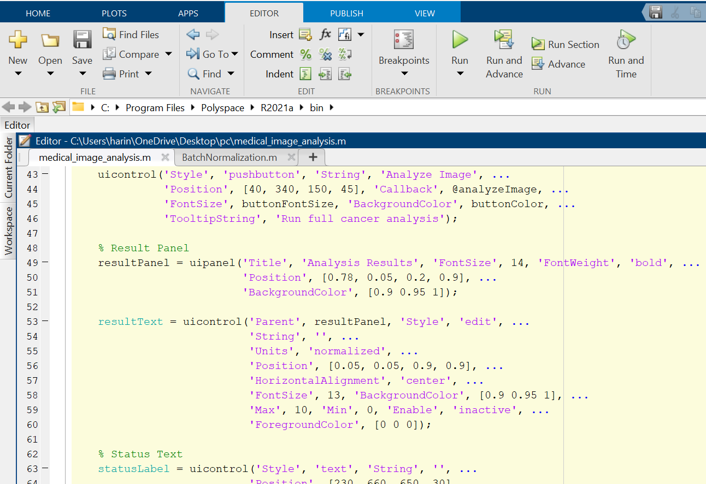
CODING
DEPARTMENT OF COMPUTER APPLICATIONS

Slide 24
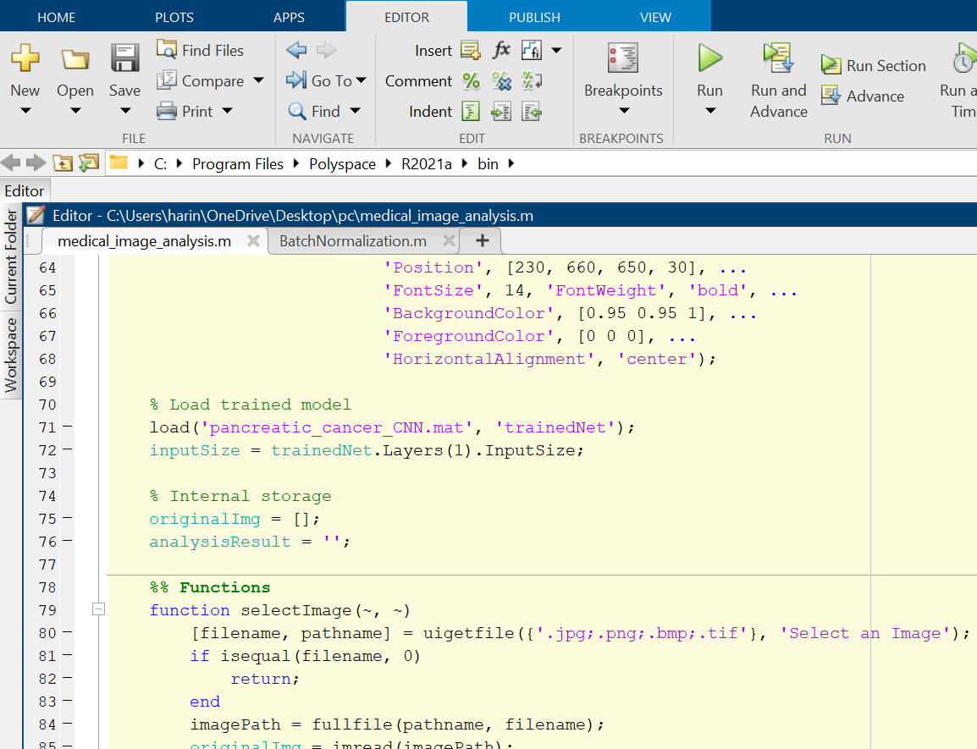
CODING
DEPARTMENT OF COMPUTER APPLICATIONS

Slide 25
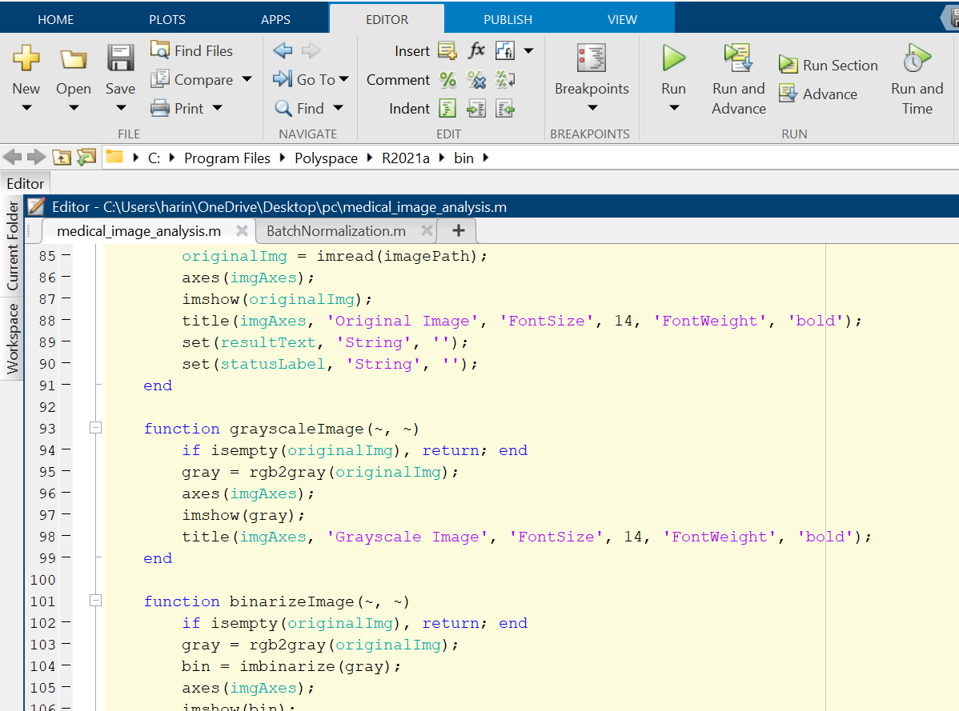
CODING
DEPARTMENT OF COMPUTER APPLICATIONS

Slide 26
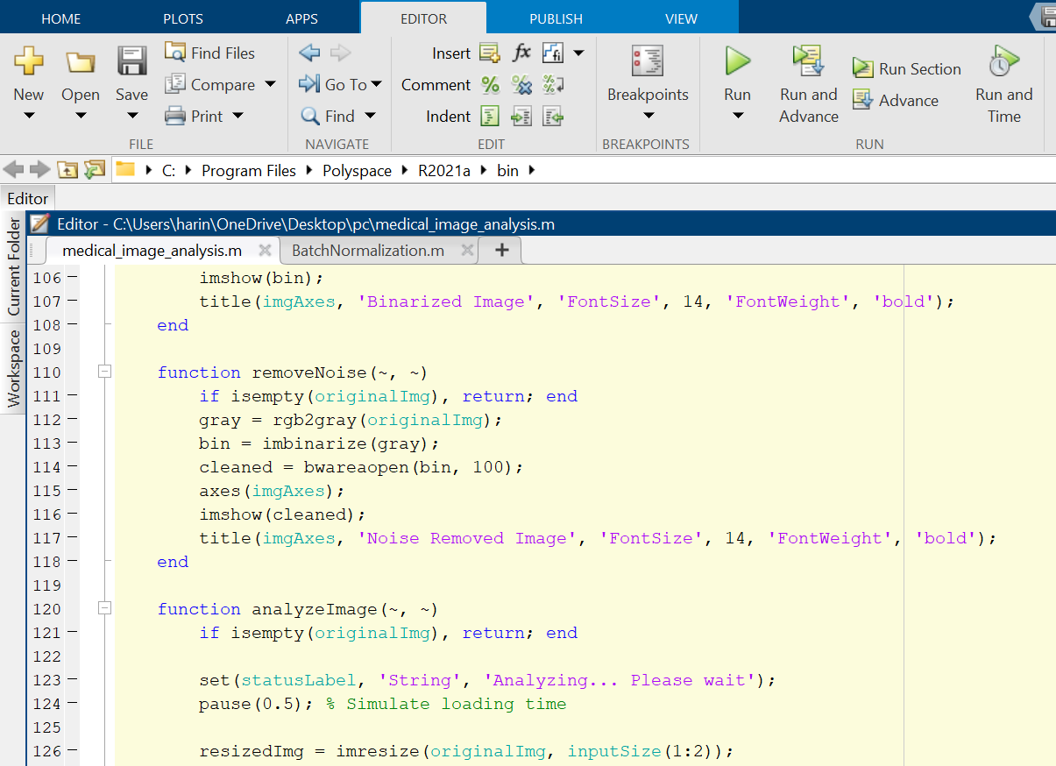
CODING
DEPARTMENT OF COMPUTER APPLICATIONS

Slide 27
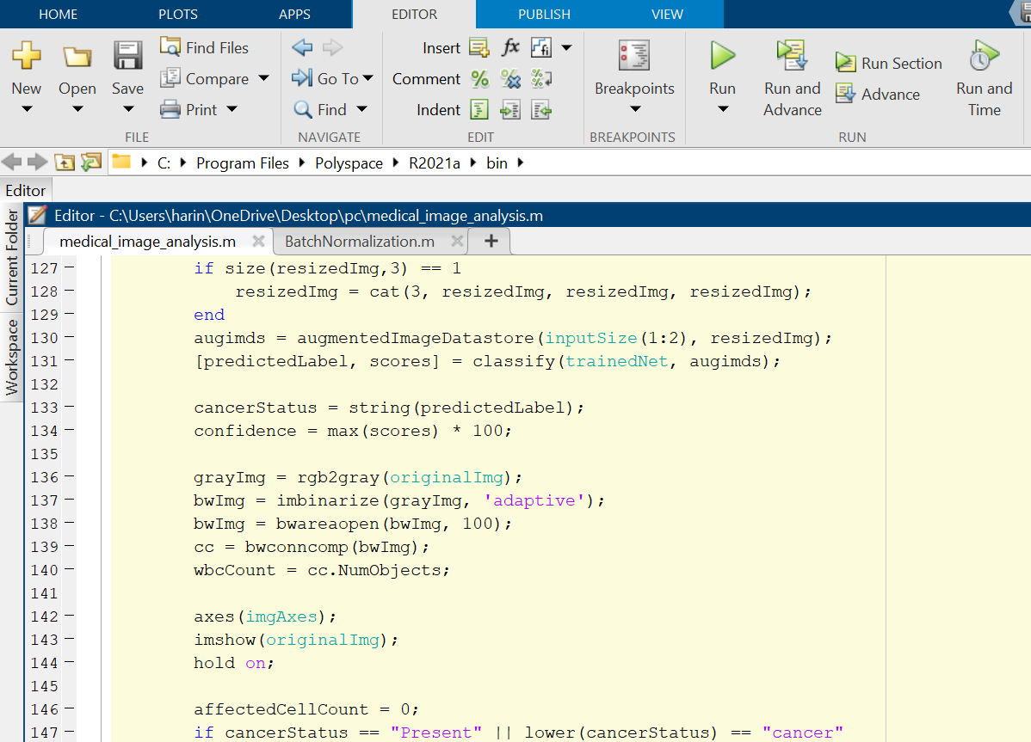
CODING
DEPARTMENT OF COMPUTER APPLICATIONS

Slide 28
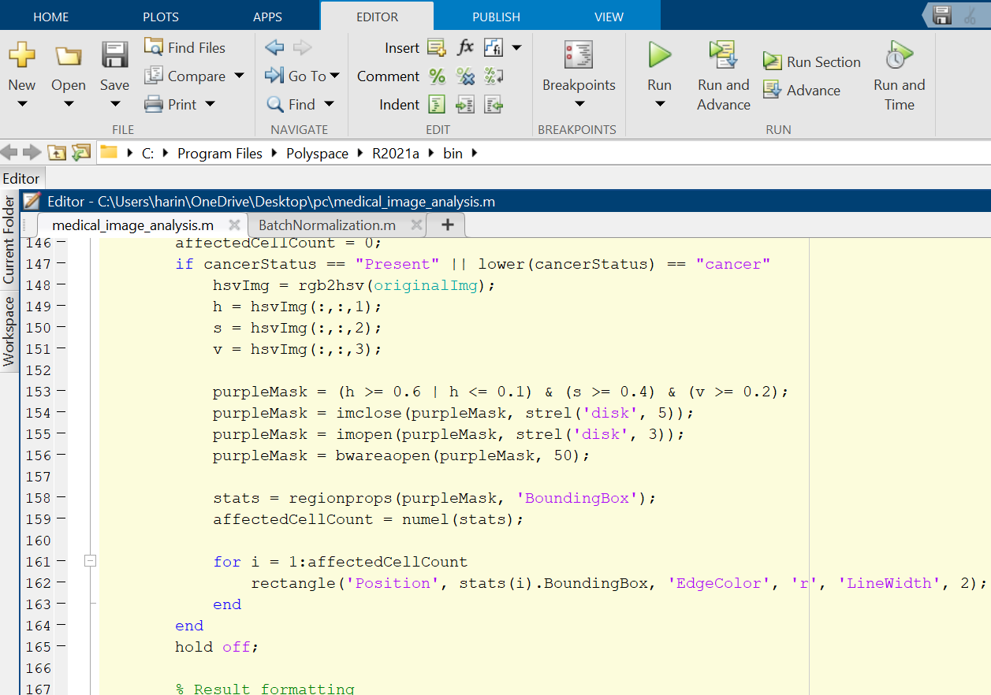
CODING
DEPARTMENT OF COMPUTER APPLICATIONS

Slide 29
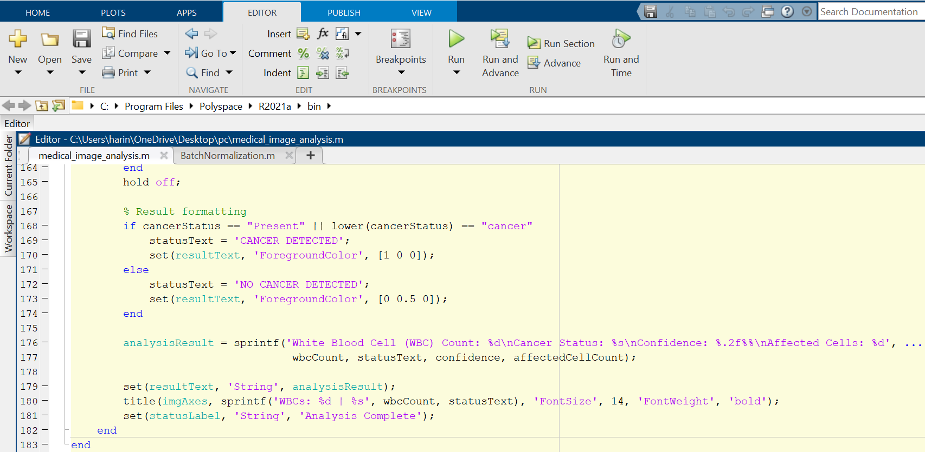
CODING
DEPARTMENT OF COMPUTER APPLICATIONS

Slide 30
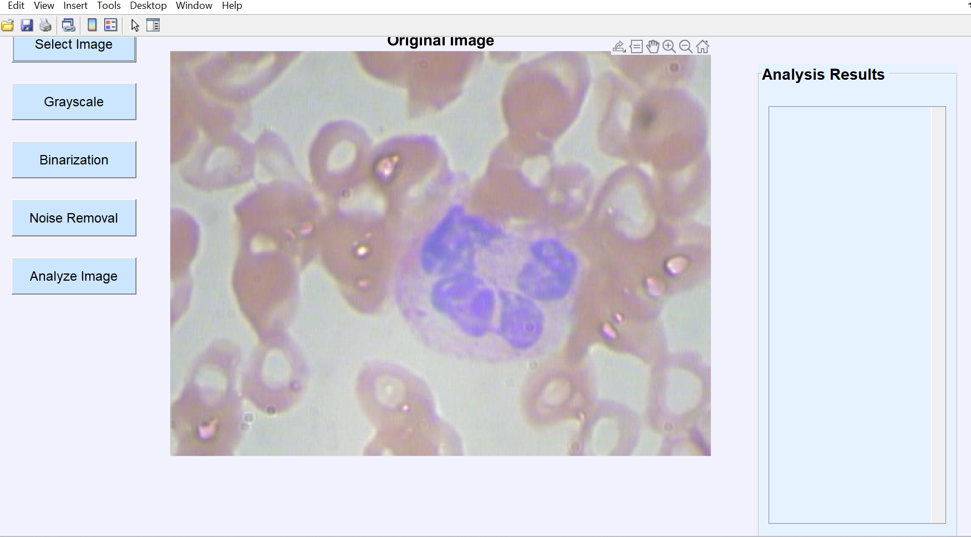
RESULT AND ANALYSIS
STEP 1 : Select Image
DEPARTMENT OF COMPUTER APPLICATIONS

Slide 31
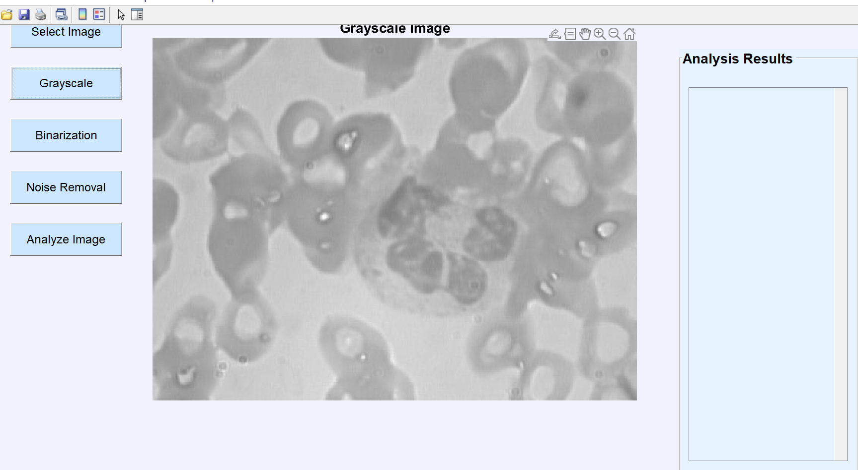
RESULT AND ANALYSIS
STEP 2 : Grayscale
DEPARTMENT OF COMPUTER APPLICATIONS

Slide 32
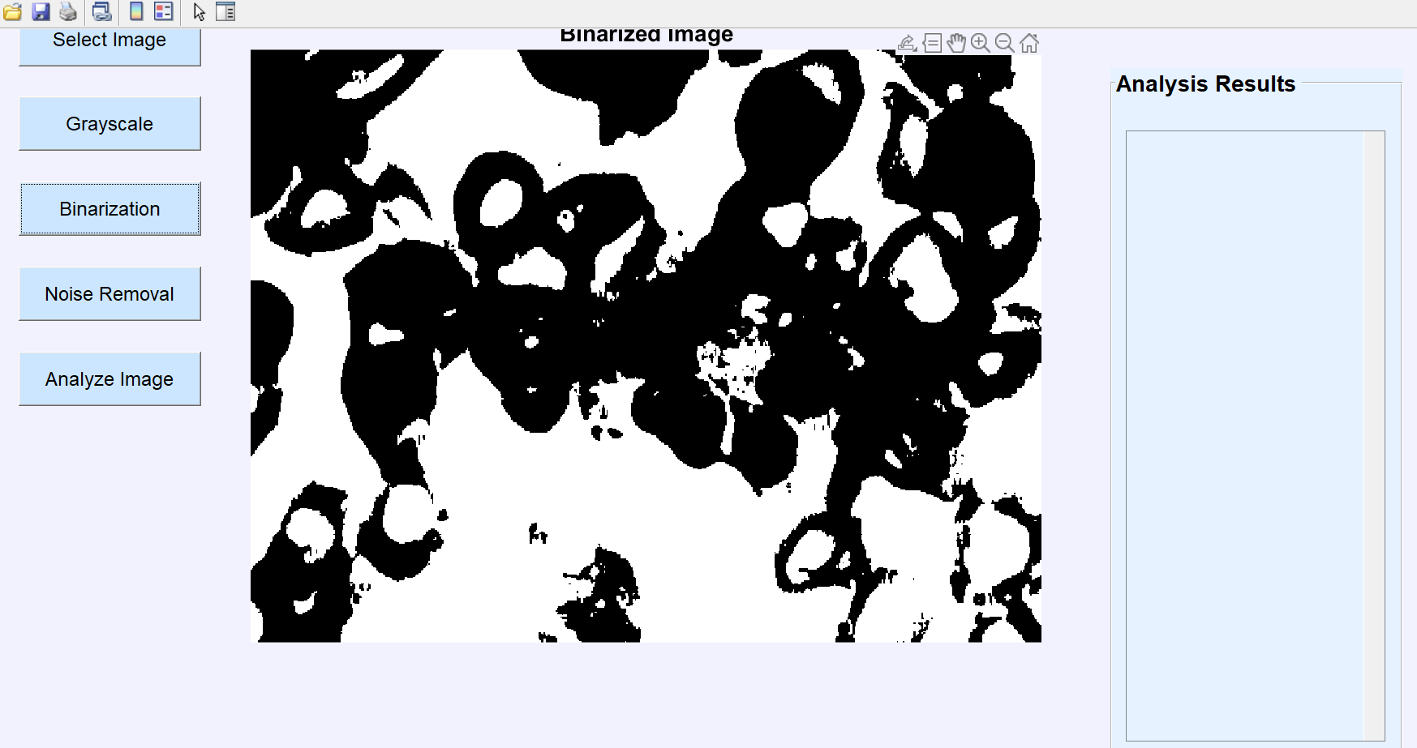
RESULT AND ANALYSIS
STEP 3 : Binarization
DEPARTMENT OF COMPUTER APPLICATIONS

Slide 33
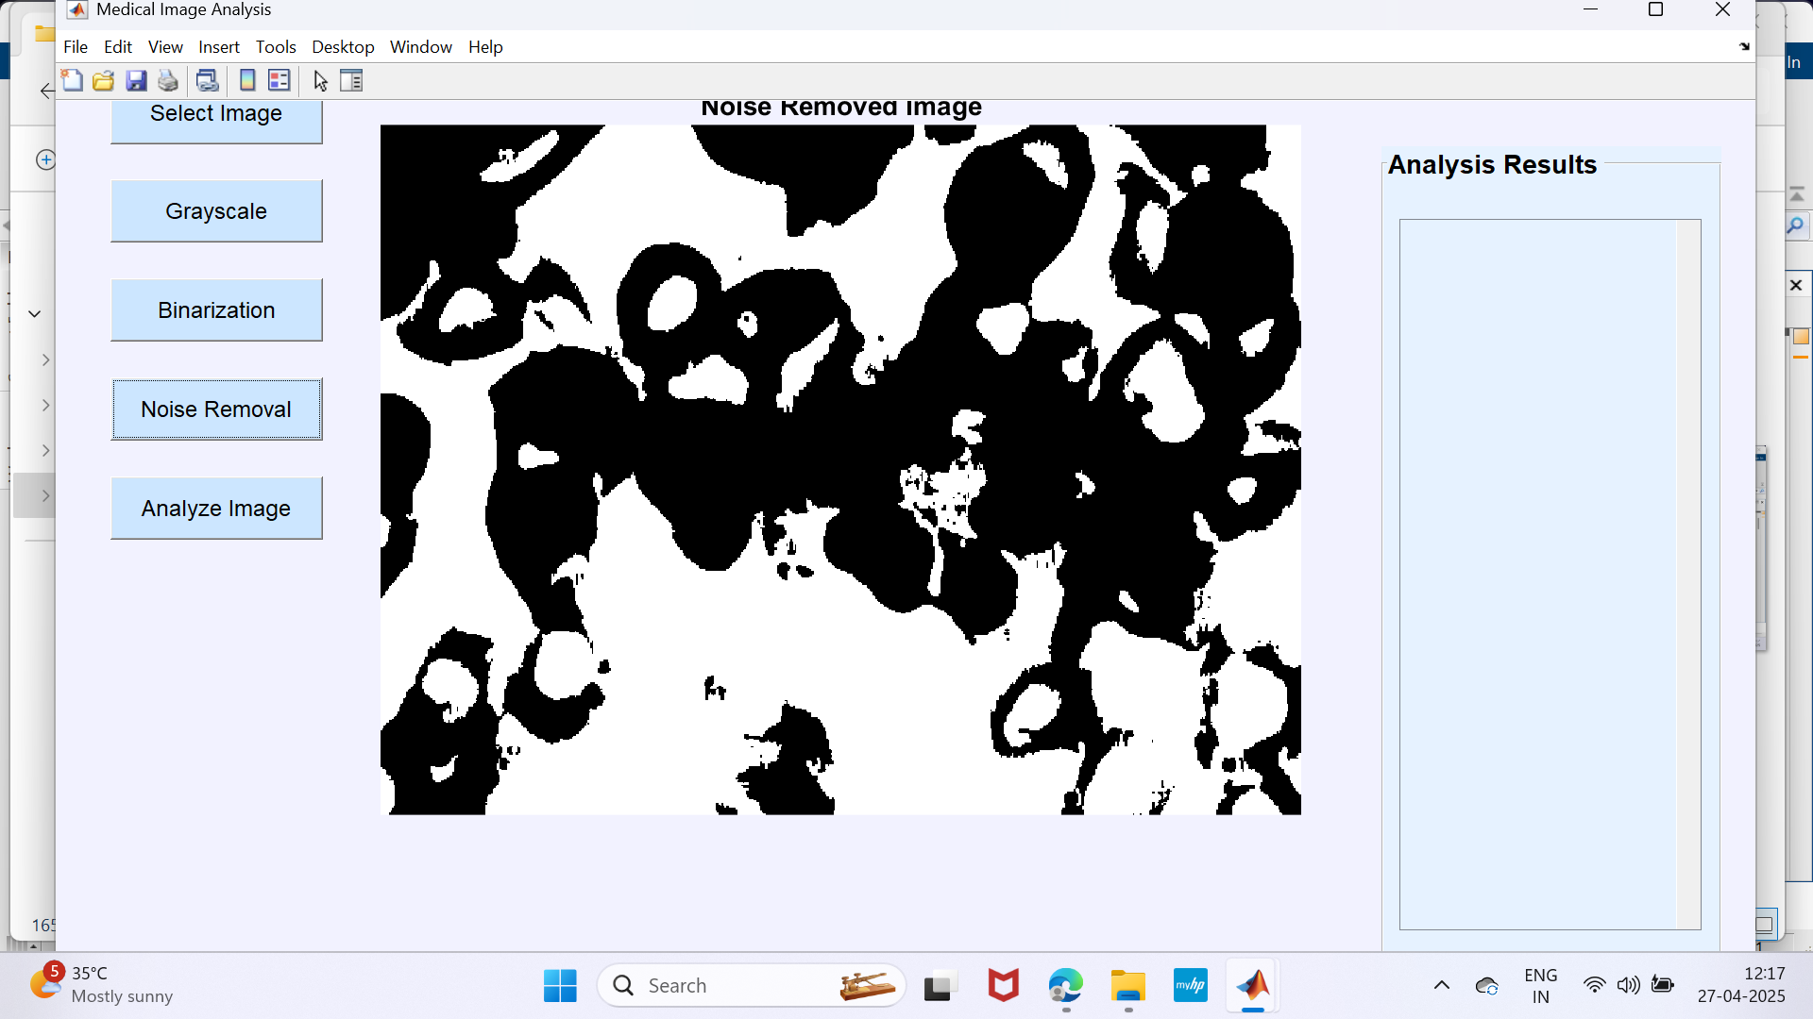
RESULT AND ANALYSIS
STEP 4 : Noise Removal
DEPARTMENT OF COMPUTER APPLICATIONS

Slide 34
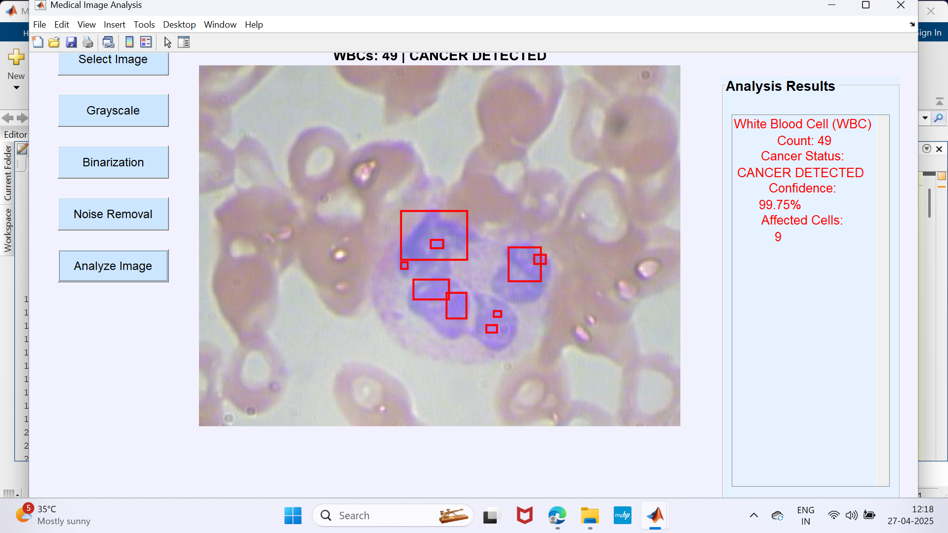
RESULT AND ANALYSIS
STEP 5 : Final Output ( Cancer )
DEPARTMENT OF COMPUTER APPLICATIONS

Slide 35
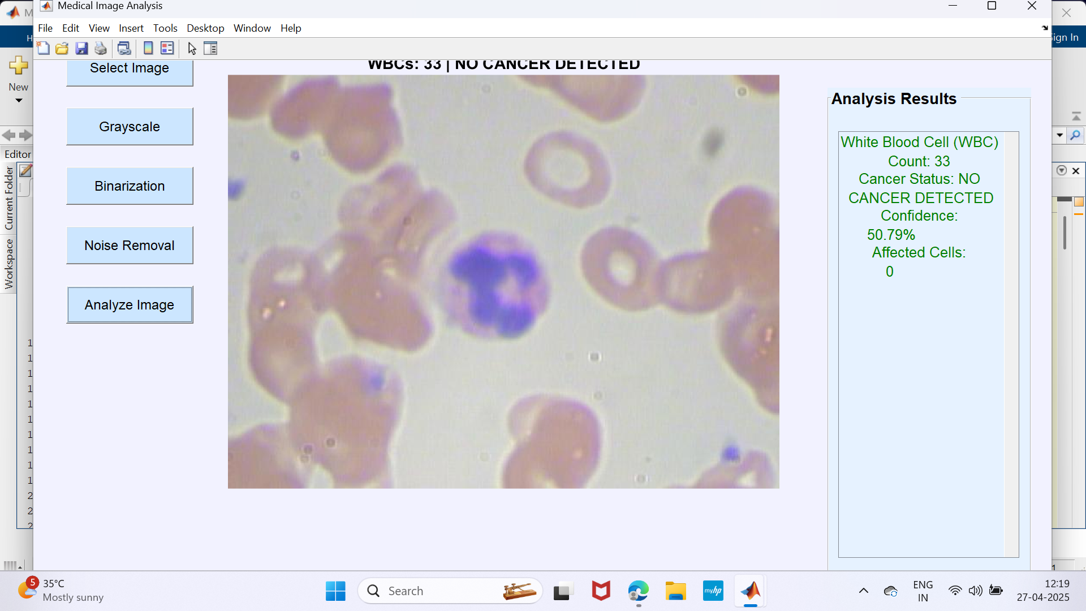
RESULT AND ANALYSIS
STEP 5 : Final Output ( Non-Cancer )
DEPARTMENT OF COMPUTER APPLICATIONS

Slide 36
MODULE IMPLEMENTATION
Chapter 1: Introduction
Automated WBC classification and cancer detection using medical images to improve segmentation and classification accuracy.
Chapter 2: Literature Review
Existing research shows advancements but lacks precise segmentation and robust classification, leading to this study's approach.
Chapter 3: Methodology
MATLAB-based GUI system with preprocessing (grayscale, binarization, noise removal), segmentation (morphological operations), and classification (CNN model).
Chapter 4: Results and Analysis
Outputs WBC count, cancer status, confidence score, and affected cell details, demonstrating high accuracy.
DEPARTMENT OF COMPUTER APPLICATIONS

Slide 37
MODULE IMPLEMENTATION
Chapter 5: Conclusion
Efficient WBC analysis and cancer detection with potential for improved datasets and refined models in the future.
DEPARTMENT OF COMPUTER APPLICATIONS

Slide 38
CONCLUSION AND FUTURE SCOPE
Conclusion:
The system efficiently detects cancer in medical images using deep learning and image-processing techniques, aiding in diagnosis.
It provides a user-friendly interface, making the analysis process accessible and streamlined for medical professionals.
Future Enhancements:
Improved Accuracy – Enhance model performance with more diverse training data.
Mobile Compatibility – Develop a version for smartphones to allow quick and convenient analysis.
DEPARTMENT OF COMPUTER APPLICATIONS

Slide 39
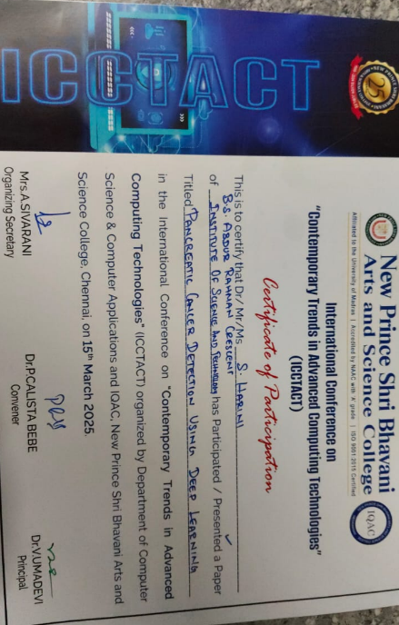
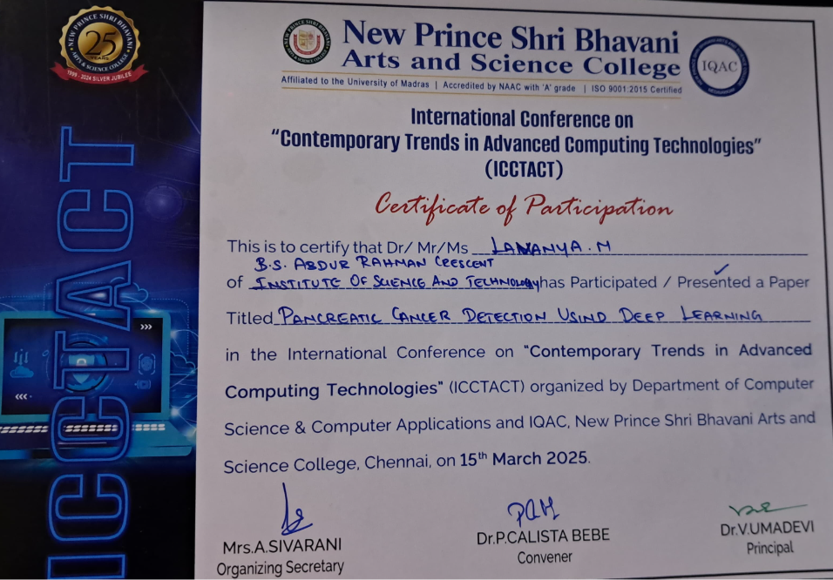
ACTION PLAN
Conference : International Conference on Contemporary Trends in Advanced Computing Technologies
College Name : New prince Shri Bhavani Arts & Science College.
Data of Conference : March 15,2025.
Mode : Virtual
DEPARTMENT OF COMPUTER APPLICATIONS

Slide 40
REFERENCES
1. "DAFFNet" is a deep learning network for classifying white blood cells. It was proposed by Yuzhuo Chen et al. in a paper published on arXiv on May 25, 2024.
2. "Pathologist-Like Explanations Unveiled" is a deep learning system for white blood cell classification. Published on arXiv, Oct 20, 2023.
3."Neural Cellular Automata" for white blood cell image classification. Published on arXiv by Michael Deutges et al. on April 8, 2024.
4."Deep Learning Model" for automatic white blood cell classification. Published by Sarang Sharma et al. in Computational and Mathematical Methods in Medicine on Dec 31, 2021.
5. “ReRNet: A deep learning network” for blood cell classification.Published by Ziquan Zhu et al. in 2023.
DEPARTMENT OF COMPUTER APPLICATIONS

Slide 41
REFERENCES
6. "WBCNet: A Novel Deep Learning Architecture" for white blood cell classification. Proposed by Alex Johnson et al. in a paper published on arXiv on March 15, 2024.
7. "Attention-Based WBC Classification" is a deep learning framework for classifying white blood cells. Published on arXiv, January 10, 2024.
8. "CellSegNet: A Deep Learning Approach" for white blood cell segmentation and classification. Published on arXiv by Emily Wang et al. on February 5, 2024.
9. "Hybrid CNN-RNN Model" for automatic classification of white blood cells. Published by Ravi Kumar et al. in the Journal of Biomedical Informatics on November 22, 2023.
10. "DeepWBC: A Comprehensive Deep Learning System" for white blood cell detection and classification. Published by Maria Lopez et al. in Medical Image Analysis on June 30, 2024.
DEPARTMENT OF COMPUTER APPLICATIONS

Slide 42

DEPARTMENT OF COMPUTER APPLICATIONS

